Slide 1

Sri Venkateswara College of
Engineering and Technology(Autonomous)
R.V.S Nagar ,Chittoor -517 127.(A.P)
Department of Computer Science and Engineering (Cyber security)
Domain: Data Analytics & Machine Learning
PROJECT TITLE: Book Recommendation and Reader Analytics
Trainer: Mrs. S. Kalpana
SUBMITTED BY:
D. Yamini Pradeepthini - 22781A3710
D. Venkatesh - 22781A3711
K. Sushmitha - 22781A3722
K. Humaya Sree - 22781A3723
K. Mounika - 22781A3724

Slide 2
INTRODUCTION
With the rapid growth of digital content, discovering relevant books has become challenging
Readers often struggle to find books matching their interests and reading habits
Traditional recommendation systems focus mainly on popularity
Machine learning enables personalized recommendations based on user behavior
Reader analytics helps understand preferences, trends, and engagement

Slide 3
ABSTRACT
This project presents a Book Recommendation and Reader Analytics System developed using data analytics and machine learning techniques.
The system aims to improve book discovery by generating personalized recommendations based on user preferences, book metadata, and interaction history.
Multiple recommendation techniques such as content-based filtering, collaborative filtering, and a Random Forest prediction model are employed to enhance accuracy and relevance.
A hybrid recommendation approach is used to handle scenarios like cold start and sparse data.
The system is implemented as an interactive Streamlit web application, providing features such as trending books, personalized suggestions, wishlist management, and reader analytics.
Experimental results demonstrate that the proposed system delivers accurate, scalable, and user-friendly recommendations, making it suitable for real-world applications.

Slide 4
OBJECTIVES
To design and develop a personalized book recommendation system using machine learning techniques.
To analyze reader preferences, ratings, and interaction patterns for effective recommendation generation.
To apply and compare multiple recommendation approaches such as content-based, collaborative, and hybrid methods.
To build a prediction model (Random Forest) that estimates the likelihood of a user liking a book.
To implement an interactive web application that allows users to explore books, apply filters, and manage wishlists.
To provide reader analytics that help understand reading trends, genre preferences, and user engagement.

Slide 5
DATASET DESCRIPTION
Primary dataset: Goodreads Books Dataset (Kaggle)
Contains approximately 10,000 books
Includes book metadata: title, author, genre, description
Rating information: average rating, ratings count
User interaction data: ratings, wishlist, reading history

Slide 6
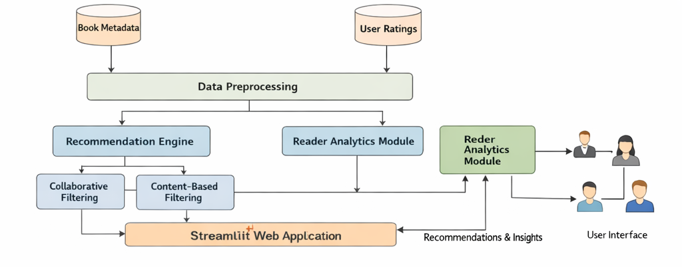
SYSTEM ARCHITECTURE

Slide 7
METHODOLOGY
Content-Based Filtering using genre, author, and description similarity
Collaborative Filtering based on user ratings and preferences
Random Forest Classifier for predicting user interest
Hybrid approach combining multiple recommendation strategies
Improves accuracy and handles cold start scenarios

Slide 8
MACHINE LEARNING MODEL
Evaluated multiple machine learning models
Random Forest selected as final model
Reasons for selection:
High accuracy (87%)
Robust to noise and overfitting
Handles complex feature relationships
Hyperparameter tuning using Grid SearchCV

Slide 9
IMPLEMENTATION
The system is implemented using Python as the primary programming language.
Pandas and NumPy are used for data cleaning, preprocessing, and feature engineering.
Scikit-learn is used to build, train, and evaluate machine learning models.
A Random Forest classifier is trained and optimized to predict user preferences.
Recommendation logic is implemented using content-based, collaborative, and hybrid approaches.
Trained models are serialized using Joblib for efficient reuse during application execution.
The user interface is developed using Streamlit, enabling real-time interaction and recommendations.

Slide 10
APPLICATION FEATURES
Home Page with Trending Books
Displays popular and highly rated books to help users quickly discover interesting content.
Advanced Filtering Options
Allows users to filter books by genre, language, and rating, enabling targeted recommendations.
Book Search and Discovery
Users can search for books by title and explore detailed book information.
Similar Book Recommendations
Recommends books similar to the selected or searched book based on content similarity.
Wishlist and Reading History
Users can add books to a wishlist and track previously viewed or liked books.
Personalized Recommendations
Generates “You May Like This” suggestions based on user preferences and wishlist activity.

Slide 11
RESULTS AND BENEFITS
Accurate Recommendations
The system provides relevant and personalized book suggestions using machine learning models.
Improved Book Discovery
Users can discover books faster compared to manual searching or generic recommendations.
Enhanced User Engagement
Features like wishlist, personalized suggestions, and similar book recommendations increase user interaction.
Efficient System Performance
Pre-trained models and optimized algorithms ensure fast response times.
Valuable Reader Analytics
The system provides insights into reader preferences, popular genres, and reading trends.
Scalable and Extendable Design
The modular architecture allows easy integration of new features and advanced models in the future.

Slide 12
CONCLUSION AND FUTURE SCOPE
Conclusion
Successfully implemented an ML-based recommendation system
Combined prediction and recommendation techniques
Delivered a user-friendly and effective solution
Future Scope
Integration of deep learning models
Real-time learning from user behavior
Mobile application development
Social and community-based recommendations

Slide 13
THANK YOU

